Slide 1
Four-Stroke Engine
NEOTECH INSTITUTE OF TECHNOLOGY
MECHANICAL ENGINEERING DEPARTMENT

Slide 2
PREPARED BY:-
1. Mistry Paras.Y
2 Arniya Dharmesh. N
3 Jani Devyani .N
4 Katba Vaishal .R
5 Pithwa Krupa. B
Guided By:-
Mukesh Keshwani

Slide 3
WHAT IS FOUR-STROKE ENGINE ?
A four-stroke engine:
is an internal combustion engine in which the piston completes four separate strokes—intake, compression, power, and exhaust—during two separate revolutions of the engine's crankshaft, and one single thermodynamic cycle
Converts into motion
Is the most common car engine type
Is relatively efficient
Is relatively inexpensive

Slide 4
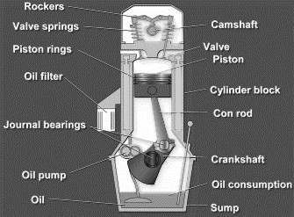
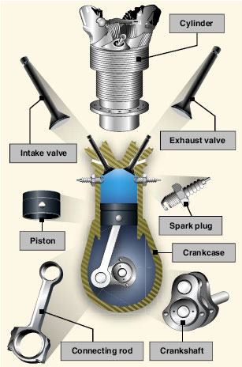
Basic Components of Four-Stroke Engines

Slide 5
Classification of four stroke engine
Classification on the basis of cycle of operation:
Otto cycle engine
Diesel cycle engine
Dual combustion cycle engine

Slide 6
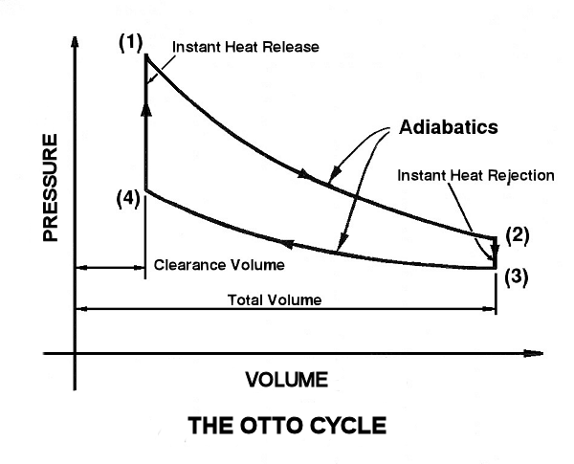
Otto Cycle engine
In Otto cycle the following processes take place :
1-2 adiabatic compression
2-3 heat addition at constant volume
3-4 adiabatic expansion
4-1 heat rejection at constant volume
An engine which follows the Otto cycle is known as
Otto cycle engine. For eg Petrol and Gas

Slide 7
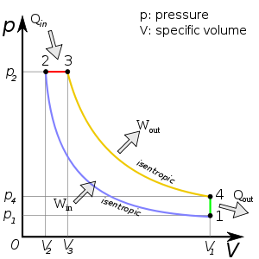
Diesel Cycle Engine
In diesel cycle the following process takes place :
1-2 adiabatic compression
2-3 heat addition at constant pressure
3-4 adiabatic expansion
4-1heat rejection at constant pressure
An engine which follows the diesel cycle is known as diesel cycle engine . For eg diesel engine

Slide 8
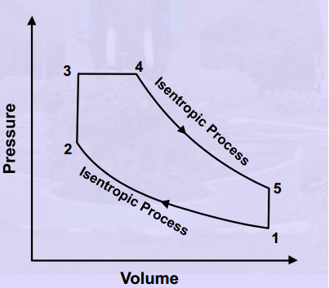
Duel Cycle Engine
The dual combustion cycle is a thermal cycle that is a combination of the Otto cycle and the Diesel cycle, first introduced by Russian-German engineer Gustav Trinkler. Heat is added partly at constant volume and partly at constant pressure, the advantage of which is that more time is available for the fuel to completely combust. Because of lagging characteristics of fuel this cycle is invariably used for diesel and hot spot ignition engines. The P-V diagram is given beside:
.

Slide 9
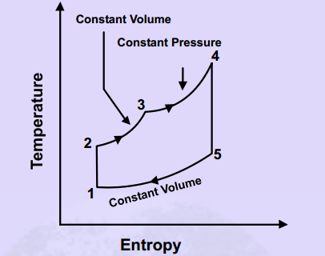
The dual cycle consists of following operations:
1-2 Adiabatic compression
2-3 Addition of heat at constant volume.
3-4 Addition of heat at constant pressure.
4-5 Adiabatic expansion.
5-1 Rejection of heat at constant volume

Slide 10
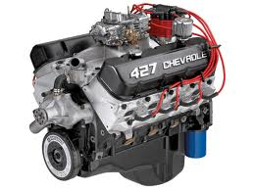
Classification on Type of Fuel Used
Petrol or Gasoline Engine
Diesel Engine
Gas engine
Alcohol-Ethyl, Methyl
Dual fuel: There are a number of engines that use a combination of two or more fuels. Some, Usually large, CI
engines use a combination of natural gas and diesel fuel. These are attractive in developing third world countries
because of the high cost of the diesel fuel. Combined gasoline alcohol fuels are becoming more common as an
alternative to straight gasoline automobile engine fuel.
Gasohol: Common fuel consisting of 90% gasoline and 10% alcohol.

Slide 11
Petrol or Gasoline Engine
A petrol engine or gasoline engine is an internal combustion engine with spark-ignition, designed to run on petrol and similar volatile fuels. It was invented in 1876 in Germany by German inventor Nicolaus August Otto. In most petrol engines, the fuel and air are usually pre-mixed before compression (although some modern petrol engines now use cylinder-direct petrol injection). The pre-mixing was formerly done in a carburetor, but now it is done by electronically controlled fuel injection, except in small engines where the cost/complication of electronics does not justify the added engine efficiency.

Slide 13
Working of a petrol engine

Slide 14
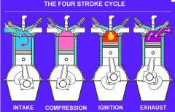
WORKING OF FOUR-STROKE ENGINE

Slide 15
Diesel engine

Slide 16
Working of diesel engine
The diesel internal combustion engine differs from the gasoline powered Otto cycle by using highly compressed hot air to ignite the fuel rather than using a spark plug (compression ignition rather than spark ignition).
In the true diesel engine, only air is initially introduced into the combustion chamber. The air is then compressed with a compression ratio typically between 15:1 and 22:1 resulting in 40-bar (4.0 MPa; 580 psi) pressure compared to 8 to 14 bars (0.80 to 1.4 MPa; 120 to 200 psi) in the petrol engine. This high compression heats the air to 550 °C (1,022 °F). At about the top of the compression stroke, fuel is injected directly into the compressed air in the combustion chamber. This may be into a (typically toroidal) void in the top of the piston or a pre-chamber depending upon the design of the engine. The fuel injector ensures that the fuel is broken down into small droplets, and that the fuel is distributed evenly

Slide 17
. The heat of the compressed air vaporizes fuel from the surface of the droplets. The vapour is then ignited by the heat from the compressed air in the combustion chamber, the droplets continue to vaporise from their surfaces and burn, getting smaller, until all the fuel in the droplets has been burnt. The start of vaporisation causes a delay period during ignition and the characteristic diesel knocking sound as the vapour reaches ignition temperature and causes an abrupt increase in pressure above the piston. The rapid expansion of combustion gases then drives the piston downward, supplying power to the crankshaft.^{[24]}
As well as the high level of compression allowing combustion to take place without a separate ignition system, a high compression ratio greatly increases the engine's efficiency. Increasing the compression ratio in a spark-ignition engine where fuel and air are mixed before entry to the cylinder is limited by the need to prevent damaging pre-ignition. Since only air is compressed in a diesel engine, and fuel is not introduced into the cylinder until shortly before top dead centre (TDC), premature detonation is not an issue and compression ratios are much higher.

Slide 18
Gas engine

Slide 19
Type of Ignition
(a) Spark Ignition (SI)
An SI engine starts the combustion process in each cycle by use of a spark plug. The spark plug gives a high voltage
electrical discharge between two electrodes, which ignites the air fuel mixture in the combustion chamber surrounding
the plug. In early engine development, before the inventor of electric spark plug, many forms of torch holes were used
to initiate combustion from an external flame.
(b) Compression Ignition (CI)
The combustion process in a CI engine starts when the air-fuel mixture self-ignites due to high temperature in the
combustion chamber caused by high compression.

Slide 20
Method of fuel input for spark ignition engines
(a) Carbureted: A device for mixing air and fuel to facilitate the combustion process
(b) Multipoint port fuel injection: One or more injectors at each cylinder intake.
(c) Throttle body fuel injection: Injectors upstream in intake manifold.
(d) Gasoline direct injection: Injectors mounted in combustion chambers with injection directly into cylinders.

Slide 21
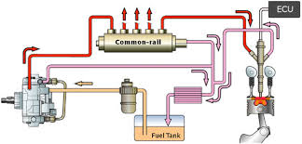
Method of fuel input for compression ignition engines
(a) Direct injection: Fuel injected into main combustion chamber.
(b) Indirect injection: Fuel injected into secondary combustion chamber.
(c) Homogeneous charge compression ignition: Some fuel added during intake stroke.

Slide 22
Position and number of cylinders of reciprocating engines
A) Single Cylinder: Engine has one cylinder and piston connected to the crankshaft.
B) In-Line: Cylinders are positioned in a straight line, one behind the other along the length of the crankshaft. They can consist of 2 to 11 cylinders or possibly more. In-line four-cylinder engines are very common for automobile and other applications. In-line six and eight cylinders are historically common automobile engines In-line engines are sometimes called Straight (e.g., straight six or straight eight).

Slide 23
C) V Engine: Two banks of cylinders at an angle with each other along a single crankshaft, allowing for a shorter engine block.
D) d. Opposed Cylinder Engine: Two banks of cylinders opposite to each other on a single crankshaft.
E) W engine: Engines of two different cylinder arrangements have been classified as W engines in the technical literature. One type is the same as a V engine except with three banks of cylinders on the same crankshaft.

Slide 24
F) Opposed piston engine: Two pistons in each cylinder with the combustion chamber in the center between the pistons. A single combustion process causes two power strokes at the same time, with each piston being pushed away from the center and delivering power to a separate crankshaft at each end of the cylinder
G) Radial engine: Engines with pistons positioned in a circular plane around a circular crankshaft. The connecting rods of the piston are connected to a master rod, which in turn, is connected to the crankshaft.

Slide 25
Valve Location
a. Valves in head (Overhead valve), also called I Head engine.
b. Valves in block (flat head), also called L Head engine. Some historic engines with valves in block had the
intake valve on one side of the cylinder and the exhaust valve on the other side. These were called T Head
engines.
c. One valve in head (usually intake) and one in block, also called F Head Engine; this is much less common.

Slide 26
On the basis of Air intake
Air Intake Process
(a) Naturally Aspirated: No intake air pressure boosts system.
(b) Super charged: Intake air pressure increased with the compressor driven off of the engine crankshaft.
(c) Turbo charged: Intake air pressure increased with the turbine compressor driven by the engine exhaust gases.
(d) Crankcase compressed: Two-stroke cycle engine which uses the crankcase as the intake air compressor. Limited
development work has also been done on design and construction of four-stroke cycle engines with crank case
compression.

Slide 27
10. Application
(a) Automobile, Locomotive, Stationery, Marine, Aircraft, Small, Portable, chain saw, model airplane.
11. Type of cooling
(a) Air cooled
(b) Liquid cooled, Water-cooled.

